Slide 1
How do emerging library technologies and trends influence the Metadata Librarian’s work in ensuring long-term, effective, and equitable discovery and access to the Libraries’ digital objects and collections?
Sean Gordon
13th of June, 2018
github.com/scgordon/mars

Slide 2


Quantitative analysis of metadata to serve the needs of a diverse community of users
Sean Gordon
13th of June, 2018

Slide 3
The story
Metadata Librarianship
Metadata Librarianship (and it’s a team effort) needs to ensure the long term and effective and equitable discovery and access to the libraries digital objects and collections throughout the Data Lifecycle.
http://www.dcc.ac.uk/resources/curation-lifecycle-model

Slide 4
Considering the user’s point of view
Quality metadata is subjective.
The needs of the user are paramount.
Metadata is created for the needs of the originating community, or the repository it resides at.
For equitable discovery and access of resources the documentation use cases of the originating discipline are not enough.
The Library serves a diverse community of scholars.
They need different metadata to discover and use a Library resource.
Notes:
Quality metadata is subjective. The needs of the user are paramount.
However metadata is created for the needs of the originating community, or the repository it resides at.
For equitable discovery and access of resources the documentation use cases of the originating discipline are not enough.
The Library serves a diverse community of scholars. They have different perspectives and interests that drive their research, different levels of digital literacy, different experiences as humans and need different metadata to discover and use a Library resource.
How can the ingest, creation, and curation of metadata for digital objects and collections include an understanding of the variety in metadata needs and provide actionable workflows to address it in order to ensure discovery and access?

Slide 5
Metadata Improvement
How can the ingest, creation, and curation of metadata for digital objects and collections include an understanding of the variety in metadata needs and provide actionable workflows to address it in order to ensure discovery and access?

Slide 6
Earth Sciences: many communities, many needs
Lets look at evaluation techniques used at earth science data repositories to analyze metadata for datasets to provide quantitative measures of the metadata needs of multiple earth science and interdisciplinary communities.
https://cadmans.weebly.com/introduction-to-earth-science.html

Slide 7
Metadata Recommendations
There are a wide variety of ways people study the earth, and almost as many different ways that they structure their metadata.
These communities have different standards that they use, and different recommendations they require and suggest for their metadata.

Slide 8
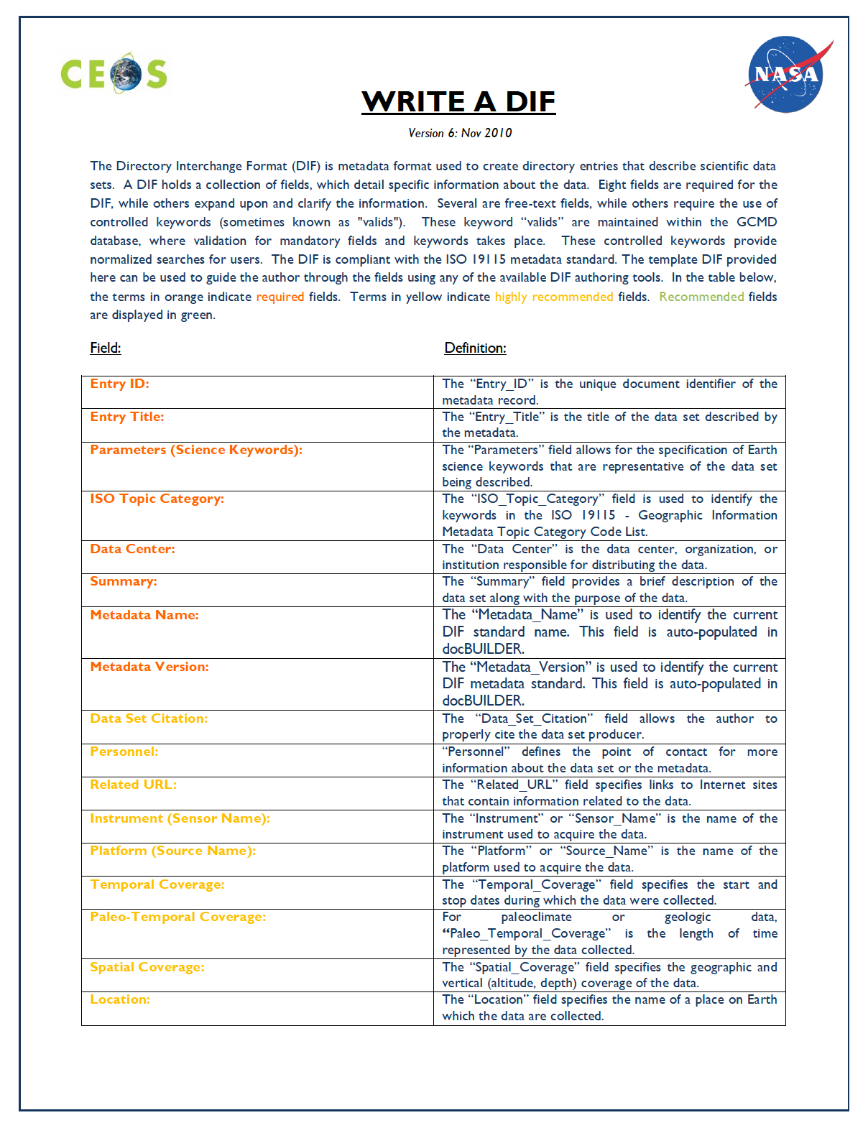
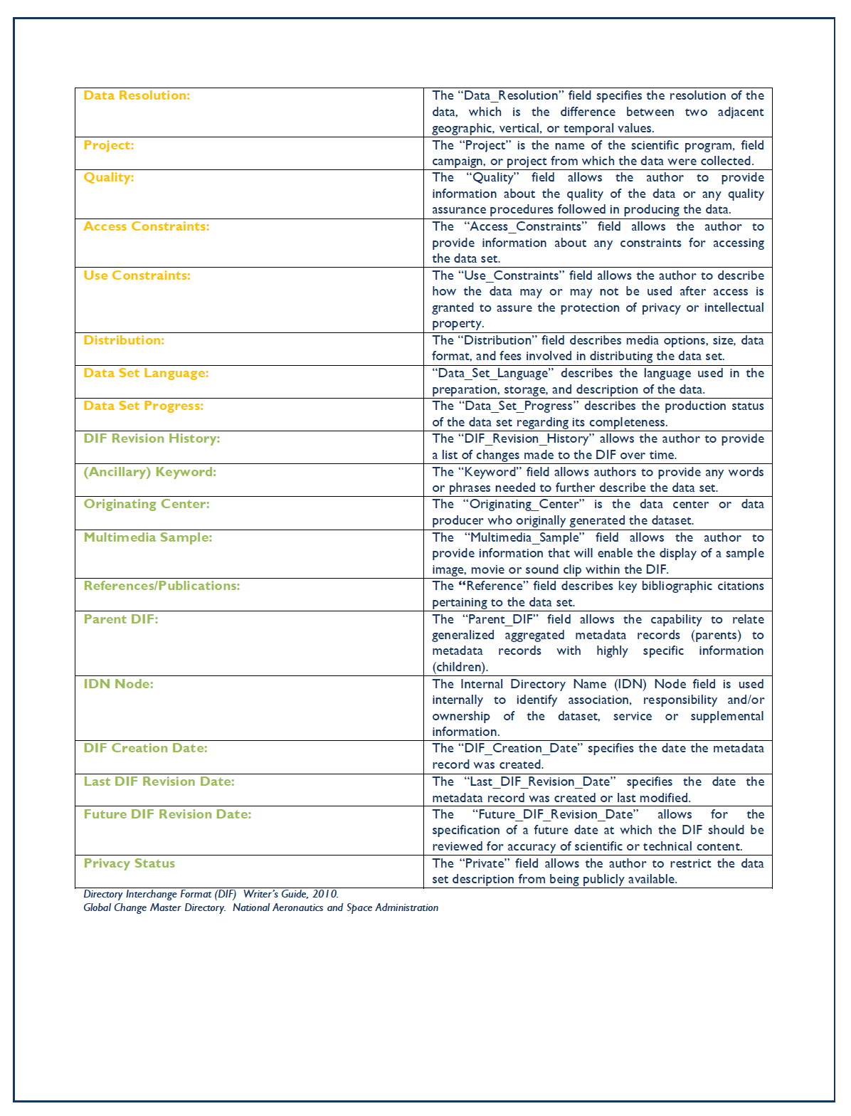
Metadata recommendation: Directory Interchange Format
Recommended
Required
Suggested
Recommended
https://gcmd.nasa.gov/add/difguide/

Slide 9
Recommendation Completeness as a quality metric
However many of the concepts in these standards and recommendations are the same, or very similar
By focusing on the similarities we can crosswalk these standards and recommendations into a conceptual framework.

Slide 10
Linked model of metadata standards and recommendations
LTER uses the EML standard (D₁) and created a recommendation with 5 levels (R₁, R₂, R_{3,} R₄, R₅)
A second community creates a standard (D₂) with recommendations at two levels (R₇, R₈).
R₄
R₈
R₅
R₇
D₁
R₂
R₃
Common documentation needs exist, particularly for the discovery use case.
Four concepts from the Identification level (R₁) are EML schema required: Resource Title, Resource Identifier, Author, and Resource Contact.(R₆)
R₁
R₆
D₂
Discovery
https://doi.org/10.1016/j.ecoinf.2017.09.005

Slide 11
(meta)Data Analysis
We can create and extend crosswalks of metadata elements from different standards in an actionable, reusable framework using XML.
We can interact with different communities to determine their metadata needs and utilizing documentation on their standards recommendations to develop XSL rubrics and translate them using this linked model in XML to apply to metadata records in a variety of standards.
We can utilize Python and BASH to investigate the results of the rubrics and create interactive reports suitable for the needs of metadata creators, curators, and managers.
We can wrap this all in a Jupyter Notebook GUI and host it through version control services such as BitBucket or Gitlab to make it easy for everyone to contribute improvements to the tests without accidently deleting the entire database.
Notes:
to identify if a metadata record, collection of records, or records at an organization contains the documentation concepts necessary to satisfy the metadata needs a different community of practice has using XSL

Slide 12
Concepts are defined for each standard
DIF Recommendation
Recommendation concepts
A
C
E
A
C
E
EML Rubric
CSDGM Rubric
A
C
E
A
E
EML1
EML 2
CSDGM 1
CSDGM 2
A = 100% C=0%
E = 50%
A = 66% C=33%
E =100%
A = 66% C=-100% E = 100%
A = 50% C=-100% E = 50%
https://doi.org/10.1016/j.ecoinf.2017.09.005

Slide 13
Improvement Guidance
We can apply these workflows to provide improvement guidance reports.
We can utilize the reports of these evaluations to determine iterative improvement of the subsets of records that most need improvement so we can devote resources equitably.
https://www.diversecymru.org.uk/wp-content/uploads/Equality-Does-Not-Mean-Justice.jpg
Notes:
Data curation stack

Slide 14
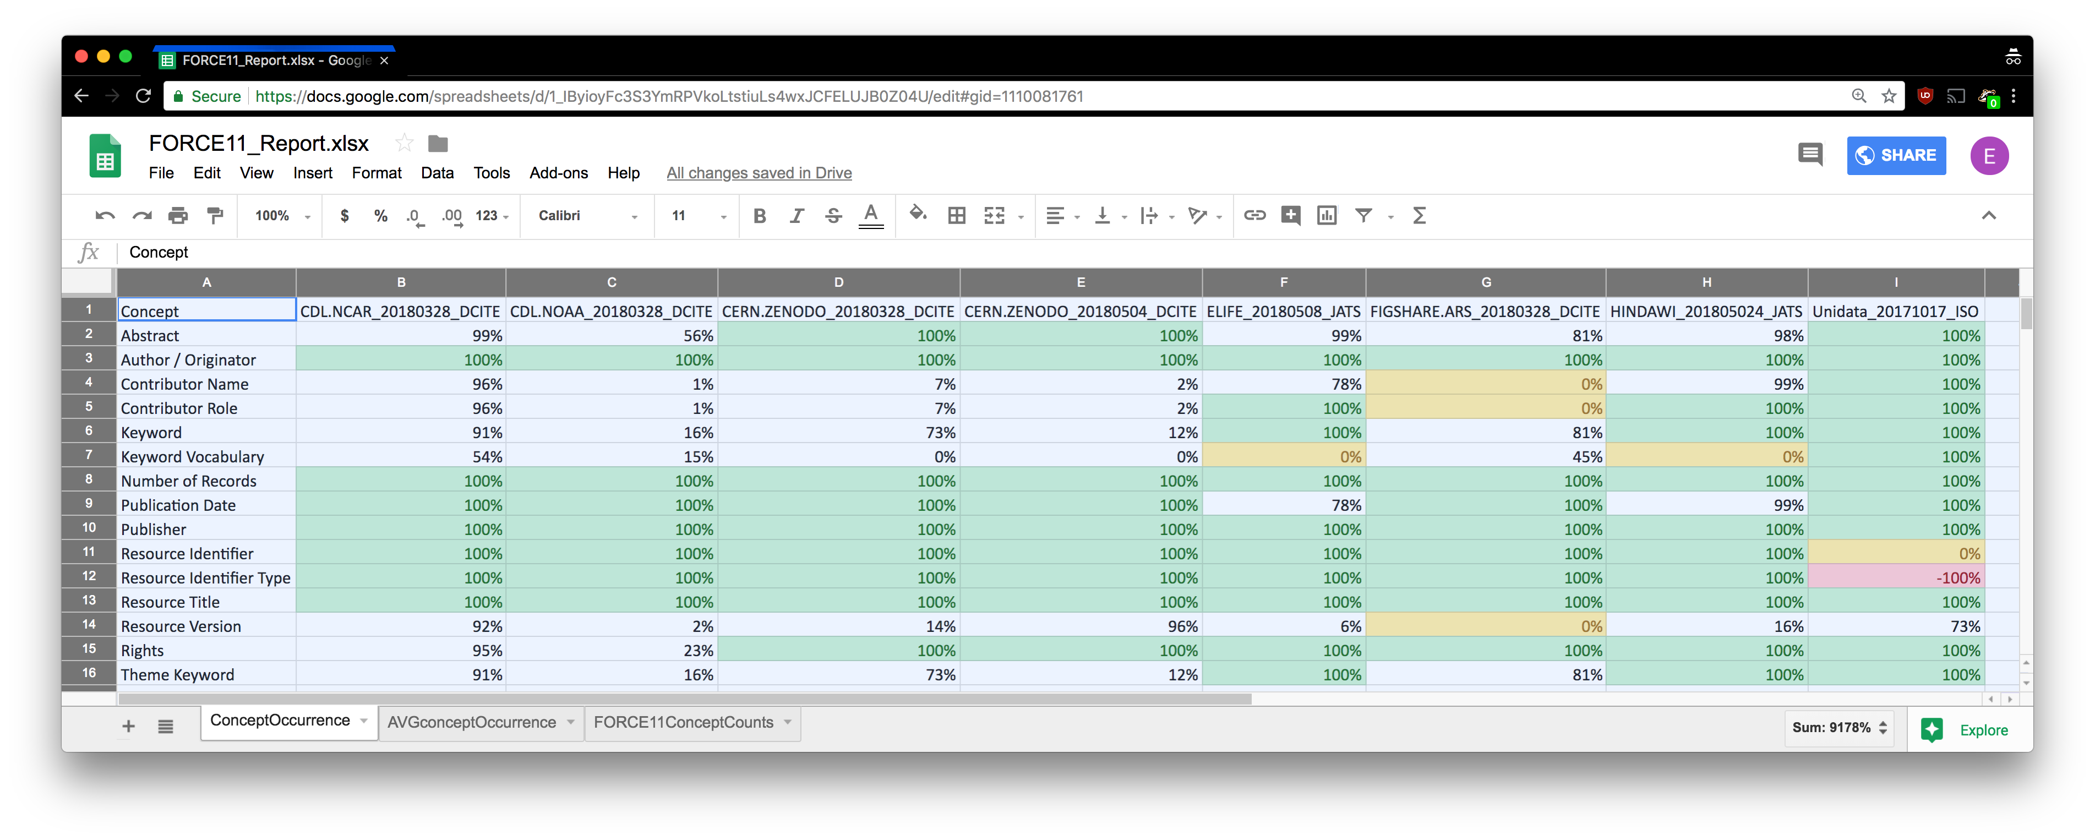
Reporting Across Collections, Standards, and Resource Types
https://docs.google.com/spreadsheets/d/1_IByioyFc3S3YmRPVkoLtstiuLs4wxJCFELUJB0Z04U

Slide 15
Guidance Reports
Concept | Occurrence % | Recommendation Profile
Resource Identifier | 2% | DataCite3.1Mandatory
Resource Identifier Type | -100% | DataCite3.1Mandatory
Author / Originator | 100% | DataCite3.1Mandatory
Author / Originator Identifier | -100% | DataCite3.1Mandatory
Author / Originator Identifier Type | -100% | DataCite3.1Mandatory
Resource Title | 100% | DataCite3.1Mandatory
Publisher | 0% | DataCite3.1Mandatory
Resource Creation/Revision Date | 100% | DataCite3.1Mandatory
Keyword | 100% | DataCite3.1Recommended
Keyword Vocabulary | 100% | DataCite3.1Recommended
Contributor Name | 0% | DataCite3.1Recommended
Contributor Role | 0% | DataCite3.1Recommended
Responsible Party Identifier Type | -100% | DataCite3.1Recommended
Responsible Party Identifier | -100% | DataCite3.1Recommended
Resource Creation/Revision Date | 100% | DataCite3.1Recommended
Resource Type | 100% | DataCite3.1Recommended
Related Resource Identifier | 100% | DataCite3.1Recommended
Abstract | 100% | DataCite3.1Recommended
Spatial Extent | 75% | DataCite3.1Recommended
-100% = Concept Not in standard
0% = Concept Not in Collection
100% = Concept in All Records
A% = Concept in Some Records
https://github.com/scgordon/ConceptMining
Notes:
The visualization is comprised of rows for each recommendation concept and columns for each standard. Cells are filled with a color or a percentage. The percentage is how many records in the sample set contain that concept.
Green represents 100%. Yellow represents 0%, a concept that the standard contains but is not in any record in the sample set for that standard. Red represents a concept missing from the standard. The table is intended to show not only how complete a standard is for a recommendation, as well as how complete the records are with respect to the standard maxima.

Slide 16
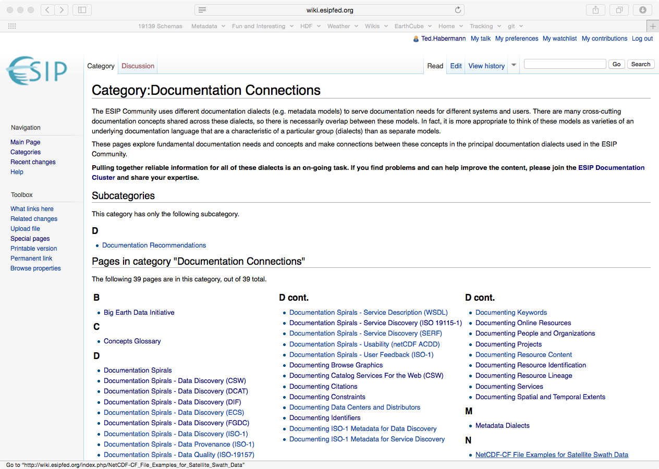
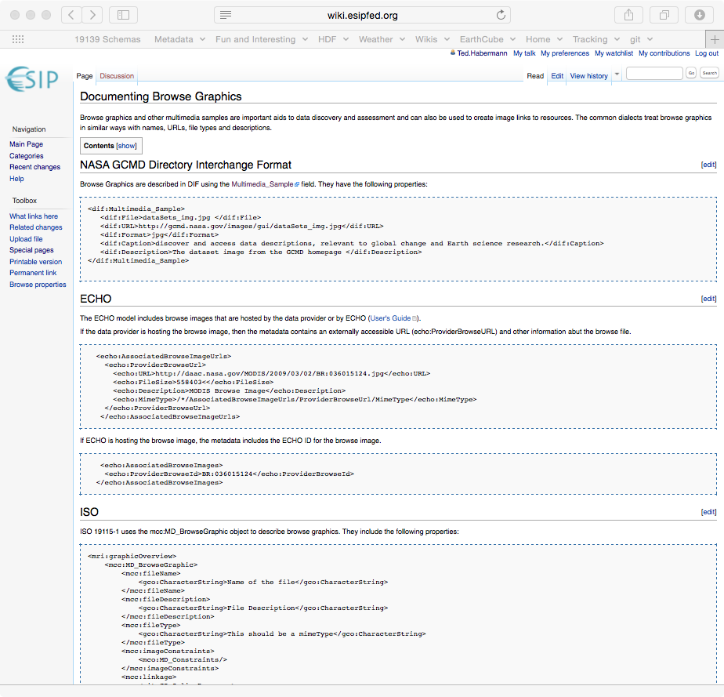
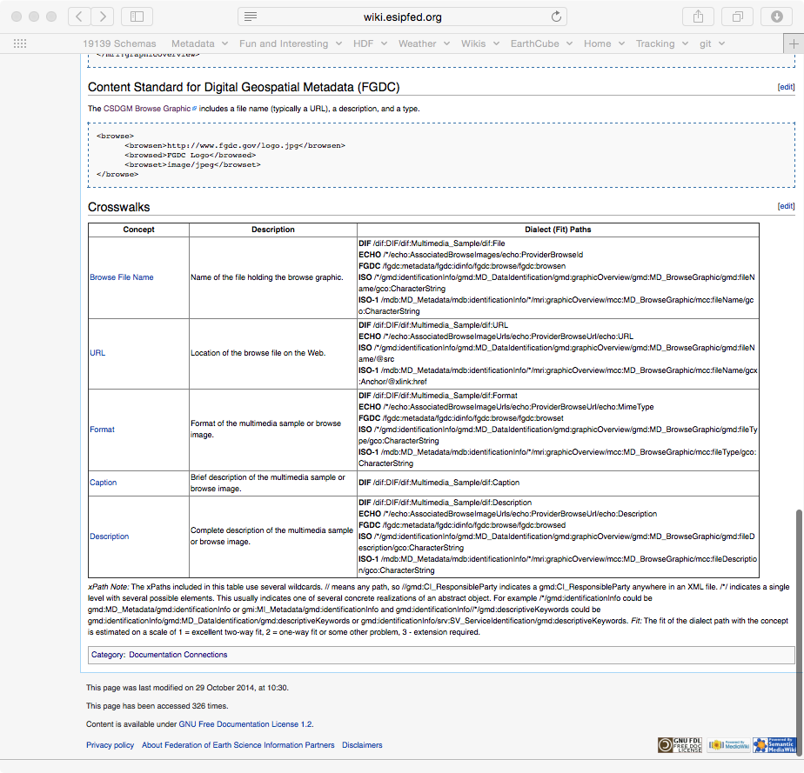
Guidance Documentation
data.ucar.edu
Sharable Metadata
Metadata
Documentation
http://wiki.esipfed.org/index.php/Category:Documentation_Connections

Slide 17
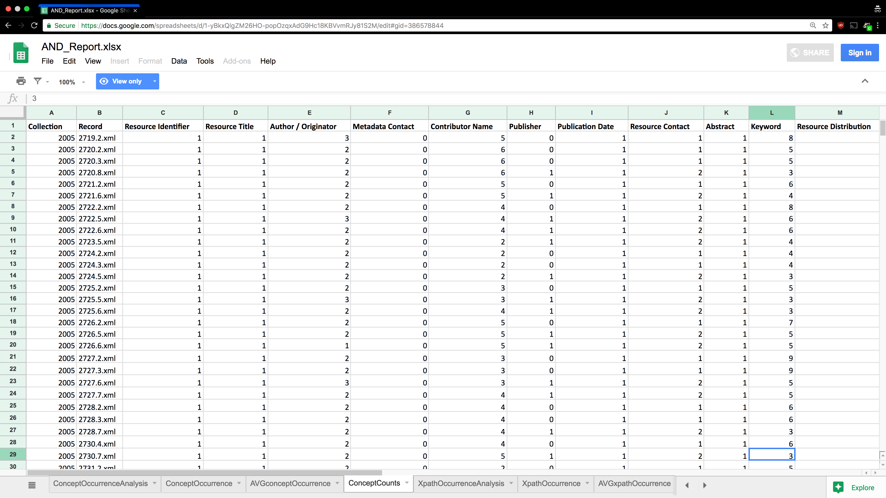
Which records need what improvement
https://docs.google.com/spreadsheets/d/1-yBkxQlgZM26HO-popOzqxAdG9Hc18KBVvmRJy81S2M/edit

Slide 18
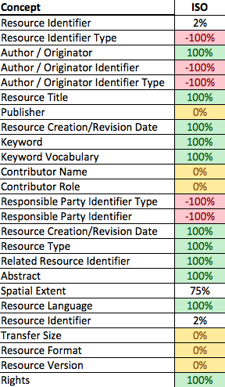
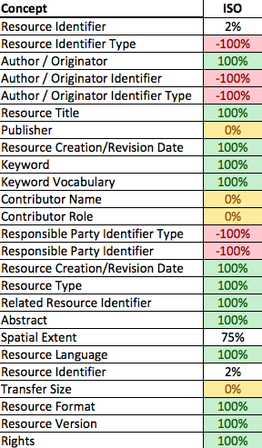
Case Study BCO-DMO’s GeoTraces Collection Metadata improvement iterations
DataCite Discovery
Summer 2016
DataCite Discovery
Oct 2016

Slide 19
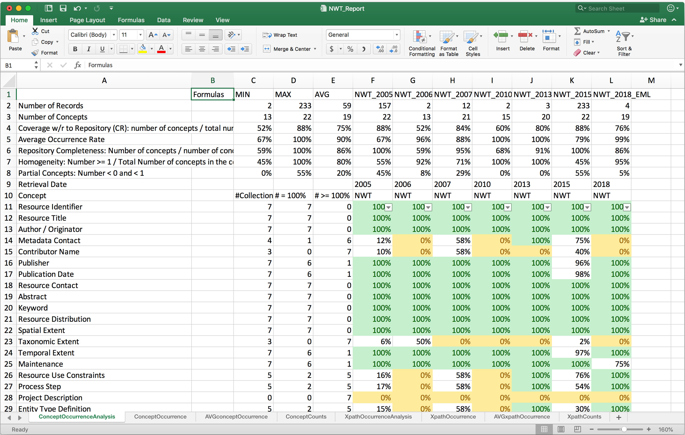
Metrics for Managers
https://github.com/scgordon/MetadataEvaluation/blob/LTERsitesThroughTime/reports/NWT/NWT_Report.xlsx

Slide 20
Measuring the improvement effort results and refining the rubrics
We can gather metrics on how students, staff, and faculty from different colleges and disciplines at the University discover, access, use, and cite the Libraries digital objects to allow for iterative improvement on the curation of the collections.
User Experience techniques, ethnographic interviews of users for feedback and development of user requirements to create CU specific rubrics to ensure quality at every part of the (meta)data lifecycle ingest creation and curation of records.
Reusable, repurposable workflows that can be driven not only by the Metadata Librarian will allow the library to directly support the metadata needs of the underserved and extend the usability and understanding of digital objects at the Library.
Notes:
Data curation stack

Slide 21
Emergent tech and trends to utilize along the way
Citations for data and code – credit for researchers, improved reproducibility.
Computational narratives like Jupyter Notebooks and RStudio are quickly becoming the go to format for describing the code and workflow and resulting data in a research package.
Shared computational environments allow for rapid deployment and improvement of workflows – bring the code to the data and provide narrative markdown and widgets inline with executable code that is remixable by any user such as JupyterHub.
We can package the research output in citable reproducible scientific packages with computational narrative notebooks using the WholeTale framework.
We can host or participate in consortiums to provide shared computational environments to make data access equitable regardless of the user’s digital literacy or strength of internet connection NDS Labs Workbench.
This is an opportunity to pilot how the Library could provide equity of access to digital research objects created at CU for a diversity of digital literacy levels – a true digital commons.

Slide 22
The future is intersectional
Not only between the silos of scholarly research but in society. Acknowledging our similarities allows us to effectively celebrate and support our differences.
Linked metadata concepts and shared vocabularies across disciplines provides a richer research experience that doesn’t need to conform any one understanding of discovery, accelerating research by all scholars at CU.
https://commons.wikimedia.org/wiki/File:All_connected_-_geograph.org.uk_-_885485.jpg

Slide 23
Questions?
sean.gordons@gmail.com
github.com/scgordon/mars

